Slide 1
Best Place to Stay in Toronto
Date: 19 Apr 2019
Rajendra Prasad Puhan

Slide 2
Introduction
Finding a rental apartment in a good location in Toronto which has similar venues in Bangalore with reasonable cost. Let’s quantify the necessities
The venues should be similar to the place I stay in Bangalore
The rent should be between CAD 1500 and CAD 2200
The number of bedrooms and bathroom should be 2
There should be at least one Indian Restaurant nearby

Slide 3
Target Audience
This project will help any person or family moving to any major city in the world.
This can be replicated for similar cases for which data is available. People reviewing this project can be included in this group.

Slide 4
Data Collection and Exploration
https://en.wikipedia.org/wiki/List_of_postal_codes_of_Canada:_M, The postal codes of Canada are available in the above link. The method web-scraping is used to collect the data from the webpage to csv using Beautifulsoup package in Python.
http://cocl.us/Geospatial_data The link to a csv file that has the geographical coordinates of each postal code.
https://www.kaggle.com/rmenon1998/bangalore-neighborhoods/data# This has Bangalore neighborhood data.
https://finkode.com/ka/bangalore.html Pin code data
https://www.kaggle.com/rajacsp/toronto-apartment-price Apartments available in Toronto with coordinates and price

Slide 5
Usage of data
Using Foursquare and geopy data find the current location in Bangalore neighborhood and top 10 venues nearby.
Plot the data in a map.
Map top 10 venues for all Toronto neighborhood and cluster in groups.
Find out the coordinates of the rental apartments using geopy data.
Find out the location of the available apartments using apartment location and price data.
Find out Indian Restaurants nearby using Foursquare with search query = ‘Indian’
Analyze the cluster groups that matches with the Bangalore location.
Finalize the place of stay by plotting all the data on a map.

Slide 6
Business Understanding
The objective is to find out best location of stay and choose suitable apartment from the list. The apartment should have similar venues nearby as with Bangalore neighborhood. For this we have to analyze the venues nearby my house in Bangalore and venues in Toronto neighborhood.

Slide 7
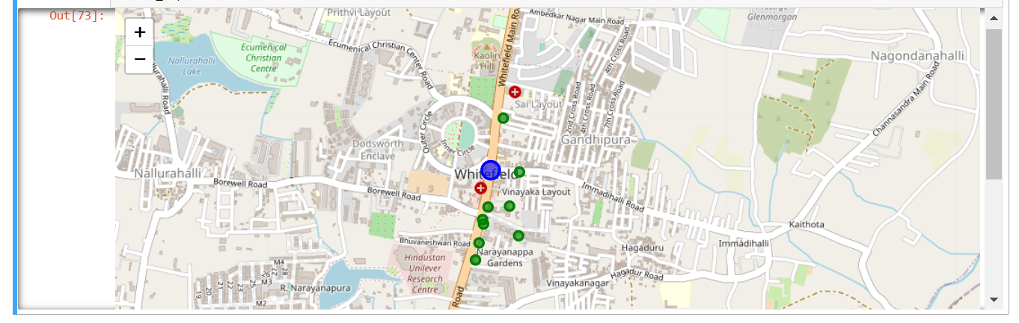
Bangalore venues

Slide 8
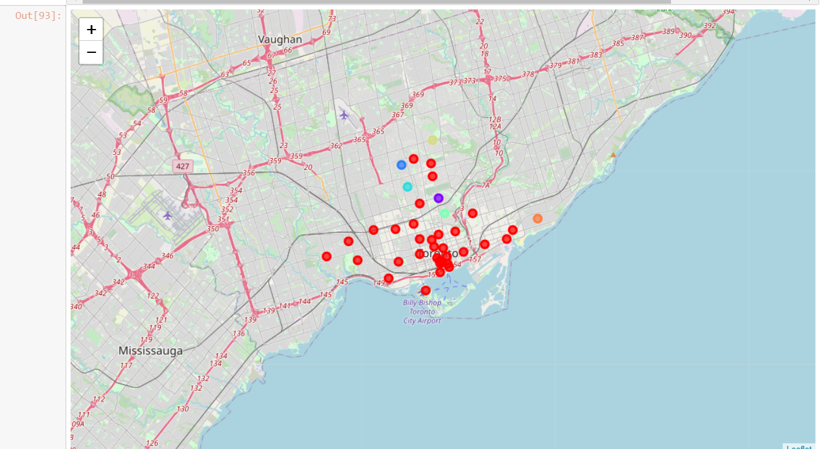
Toronto neighborhood clusters

Slide 9
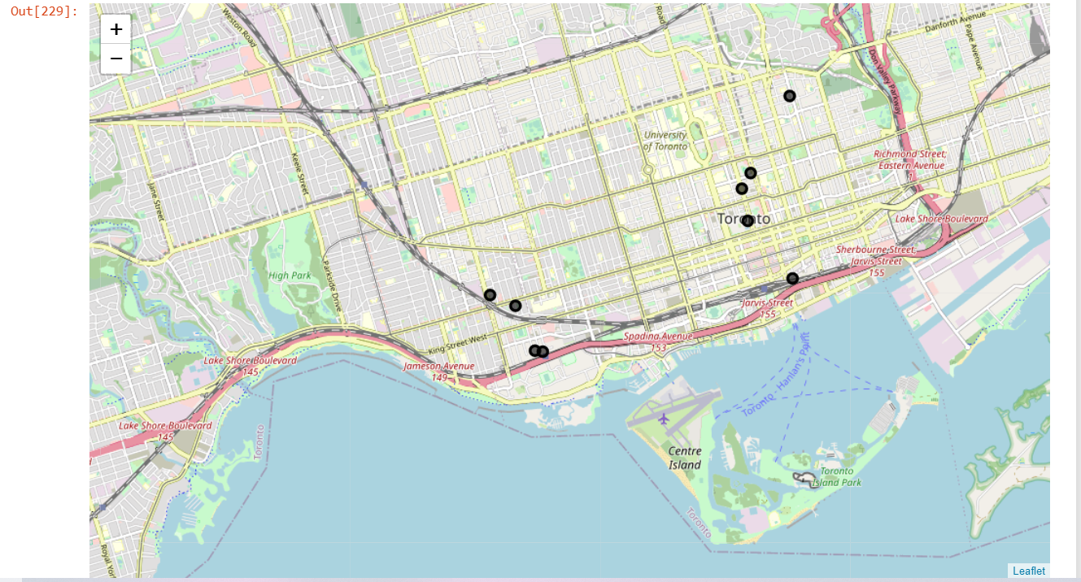
Available Apartments

Slide 10
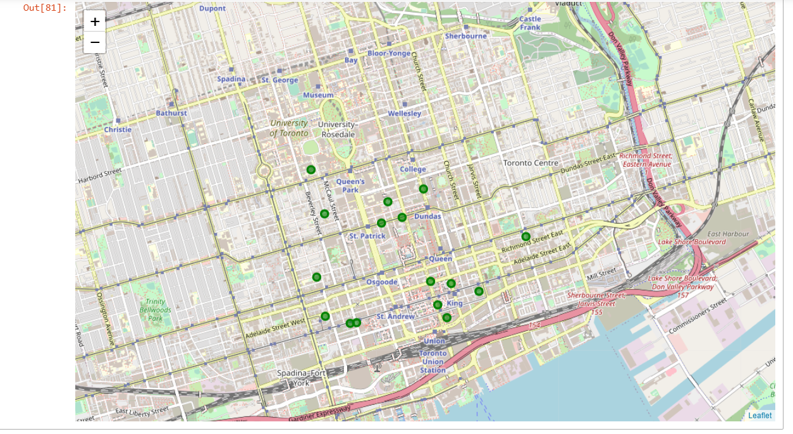
Indian Restaurants in Toronto

Slide 11
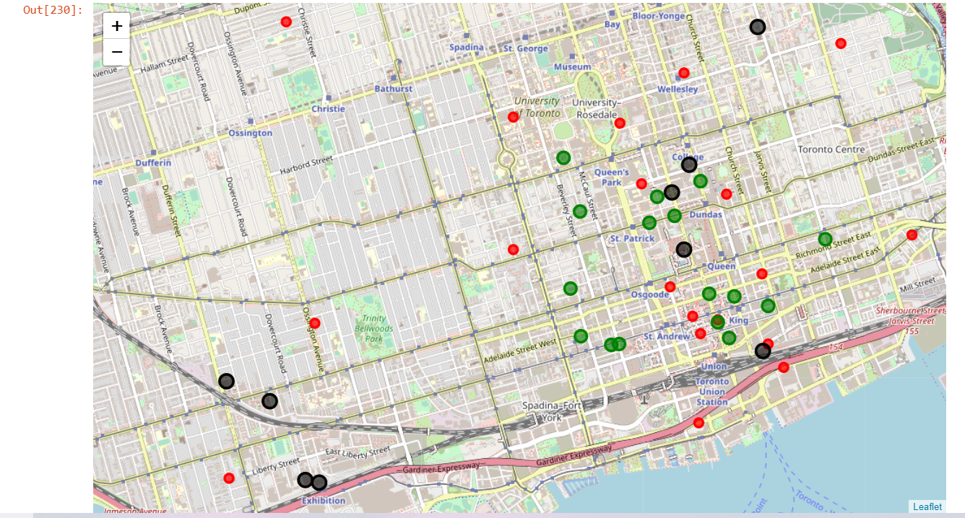
Combined Map

Slide 12
Results
As per the choice of cluster, apartment location and nearby Indian restaurant apartment no 1 is selected. The selected option satisfies all our required criteria.
The apartment is in a similar cluster as in Bangalore
The rent is CAD 1500
There are 2 bedrooms and 2 bathrooms
There are multiple Indian Restaurant nearby

Slide 13
Assumptions
The venues in the neighborhoods in Bangalore and Toronto may not match as per the clustering groups as the culture and lifestyle are different.
The clusters/groups are created for the neighborhoods of Toronto with available data. These can be improved or enhanced using refining the data.
The graph used for selection of k in Elbow method is not quite significant.
Collection of real time data is difficult so sample data from 2018 is used for rental apartment price and location.
This project can be replicated for analysis of any locations having Foursquare data.
The quality of the house and furniture can vary as per Price
Facilities available and quality of the apartments are considered as equivalent

Slide 14
Conclusion
This project can be very helpful for people migrating to other city or country.
This will help choosing best location of stay and finding great and interesting venues nearby.
The process of learning and implementing in a real-time project has been a great experience for me.
The tools used in the project are very powerful and can help anyone solving real time problems.

